Slide 1
Indian Institute of Technology Bombay, DSP Internship.
Design project through Inter-Institute Faculty-Student Peer Collaboration leading to Development of Various Applications based on Digital Signal Processing.
Indian Institute of Technology Bombay
Industry Guide – Prof. V. M. Gadre
PVG’S College Of Engineering and Technology, Pune
College Guide – Prof. M. Atre
Prof. T. Khatavkar
Prof. M. Potdar
(Group 5)
Sakshi Vispute
Gauri Mundada
Rutuja Gaikwad
Pratik Hole
Kaushal Rane

Slide 2
Problem Statements
Steganography With Multiple Data Hiding Using LSB Techniques.

Slide 3
What is Steganography?
Steganography is the art and science of hiding one kind of data into another in such a way that no one, apart from the sender and intended recipient, suspects the existence of the secret data .

Slide 4
Objectives
We present an end-to-end video steganography approach.
We present an end-to-end Colour image steganography approach.
To do multiple data hiding, to increase data security.

Slide 5
Image Steganography
Text inside Image
Image inside a Image
Stego Key
Cover Image
Embedding
Process
Stego
Image
Secret Image
Or Text

Slide 6
Video Steganography

Slide 7
Why Video Steganography ?
1. Imperceptibility ​
2. Capacity ​
3. Robustness ​

Slide 8
Block diagram - Encoding
Input cover video (AV) file
collect information of the input file
Cover frames
Secret Image/ Text
frame
Other frames
Stego frame
Stego video

Slide 9
Block diagram - decoding
Stego Video
collect information of the input video
Cover frames
Secret Image/ Text
Stego frame
Other frames
Frame
Cover Video .Avi file

Slide 10
Algorithm :- Steganography using LSB
Algorithm Type 1:- Encoding for Text in Image
Step 1: Input cover video file or stream.
Step 2: Read required information of the cover video.
Step 3: Break the video into frames.
Step 4: Find ASCII value of character or text to be hidden, this ASCII value is converted into binary format.
Step 5: Embed this binary value into LSB of RGB binary value of pixel.
Step 6: Regenerate video frames.
Step 7: Obtain stego video file or stream.

Slide 11
Algorithm :- Steganography using LSB
Algorithm Type 1:- Decoding for Text in Image
Step 1: Input stego video file or stream.
Step 2: Read required information from the stego video.
Step 3: Break the video into frames.
Step 4:Extract the binary value of character from LSB of RGB binary value of pixels.
Step 5: Reconstruct the secret information.
Step 6: Regenerate video frames.
Step 7: Regenerate cover video .

Slide 12
Algorithm :- Steganography using LSB
Algorithm Type 2:- Encoding for image in Image
Step 1: Input video file .
Step 2: Read required information from the video.
Step 3: Break the video into frames.
Step 4:Take 2 MSB bits from pixels of secret image.
Step 5:Hide these 2 MSB bits of secret image in 2 lsb bits of cover image (frame) using shift operator.
Step 6: Regenerate video frames.
Step 7: Obtain stego video file or stream.

Slide 13
Algorithm :- Steganography using LSB
Algorithm Type 2:-Decoding for image in Image
Step 1: Input stego video file or stream.
Step 2: Read required information from the stego video.
Step 3: Break the video into frames.
Step 4:Take cover image take binary value of pixels in form of RGB
Step 5: Now select 2 LSB bits of these pixel values, Set these 2 LSB bits of cover image as 2 MSB bits of images to be extracted.
Step 6: Reconstruct the secret image.
Step 7: Regenerate video.

Slide 14
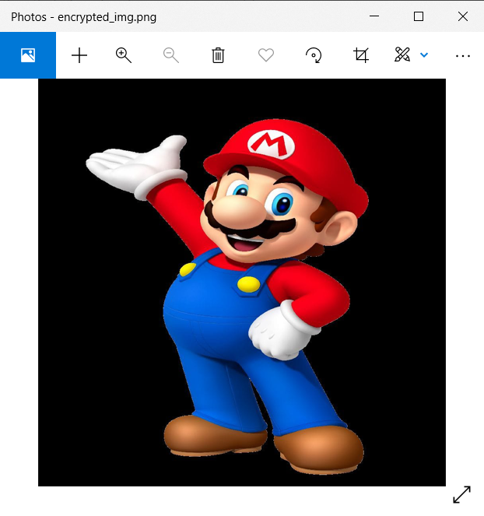

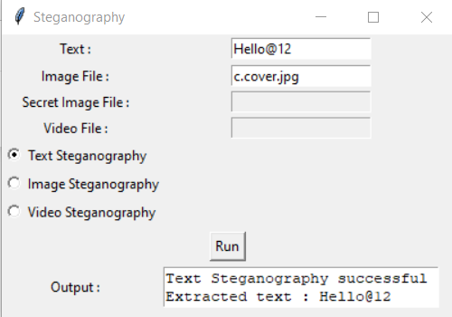
Image Steganography Output (text in image)

Slide 15
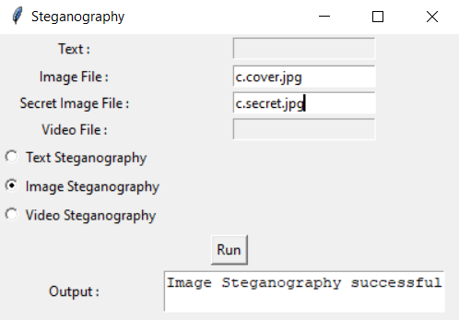

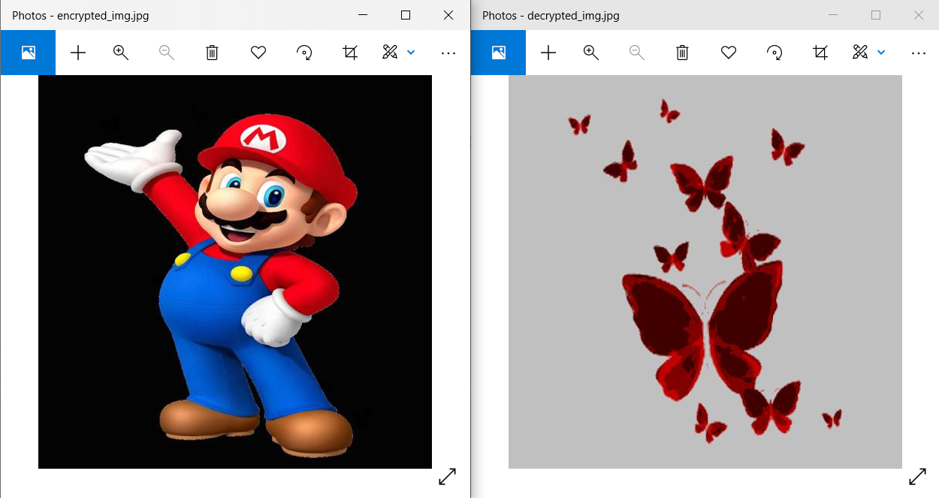
Image Steganography Output (image in image)

Slide 16
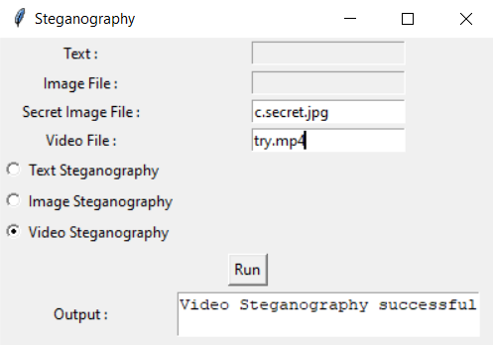
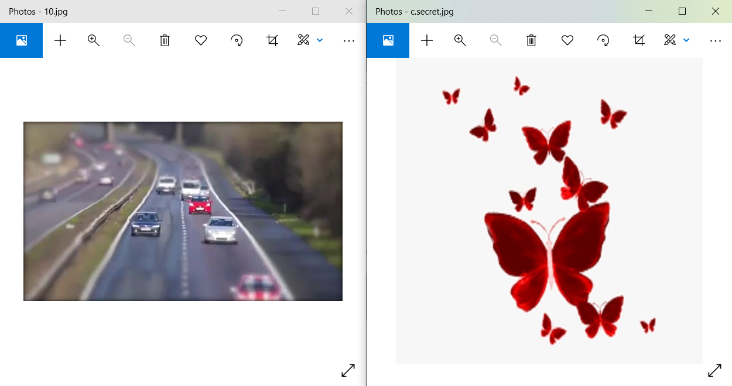
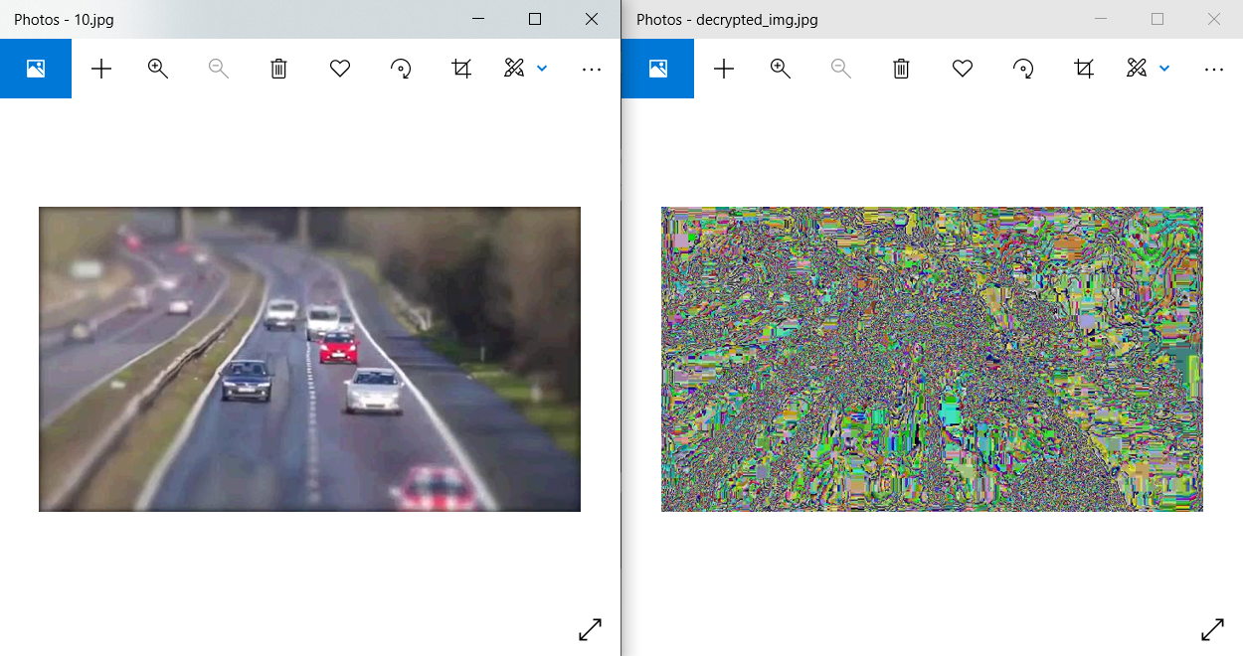
Video Steganography Output

Slide 17
Advancement
Try to use different algorithm in order to get more accuracy.
In future advancement different methods can be used to apply steganography such as DWT, DFT, DCT method or Pixel Value Differencing (PVD).

Slide 18
Conclusion
Proposed method of video steganography improves security and it can hide more information compared to other methods.
Least Significant Bit Embeddings (LSB) are a general steganographic technique that may be employed to embed data into a variety of digital media, the most studied applications are using LSB embedding to hide one image inside another.
This technique utilizes cover video files in spatial domain to conceal the presence of sensitive data .
The app like interface in python is easy to use and understand.
The LSB technique still needs advancement to provide effective steganography solutions.

Slide 19
Real life application
It can be used in military, industries, government…
It can be used whenever protection against data alteration and data hiding is needed, as the observer have no idea that a secret data is hidden in a video. So there will be no chances to alter the data

Slide 20
Atmanirbhar Bharat
India has seen an explosive rise in demand for reliable Data Security solutions in the past few decades.
However, a large majority of state-of-the-art encryption software's used in India are non-indigenous and prone to various risks.
The approach we are proposing can be easily developed further into an online application or software, and satisfy this prevalent need of a Made in India solution.
It can be used by government organizations for transferring sensitive national data, to individuals sharing private files securely.

Slide 21
THANK YOU!!!!

